Slide 1
CHAPTER 3
The file in context
Files are not completely specified simply by the data they contain. Each UNIX file also possesses a number of additional primitive properties necessary for the administration of what is a complex, multi-user system. It is these additional properties, and the system calls that manipulate them, that we will study in this chapter.
Prof. Ju-Hong Lee, Data Science Lab, Inha Univ

Slide 2
3.1 Files in a multi-user environment

Slide 3
Users and ownerships (1/3)
Owner
Every file on a UNIX system is owned by one of the system’s users.
Owner is normally the user who created the file.
The owner’s actual identity
user-id (often abbreviated to uid)
uid associated with a particular username
keith:x:35:10::user/keith:bin/ksh
in a /etc/passwd

Slide 4
Users and ownerships (2/3)
Each UNIX process is normally associated with the uid of the user who started that process
When a file created, the system establishes ownership by referring to uid of the creating process
Ownership change
superuser or file’s owner
superuser(username=root, uid=0)
$ touch a.txt
ls
uid =100
uid =100
uid =100
uid =100
uid =100
user’s shell
ps
user’s shell
touch a.txt
a.txt
uid =100
wc
uid =100

Slide 5
Users and ownerships (3/3)
Group
Each user belong to at least one group, possibly more
$ usermod -G group1,group2 user1
$ id
uid=509(user1) gid=509(group1) groups=509(group1),510(group2)
Defined in /etc/group
The group’s actual identity
group-id (often abbreviated to gid)
gid associated with a particular groupname
gid, uid is inherited by the process that the user initiate.

Slide 6
Effective user-and group ids
Real user-id (ruid)
the uid of the user who initiated a process.
Effective user-id (euid)
used to evaluate privileges of the process to perform a particular action
In most cases, effective and real user-ids coincide.
Effective user-and group ID determines our files access permission.
uid = 0
in most cases
in special cases
/etc/shadow
ruid =100
euid =100
ruid =100
euid =100
user’s shell
ps
ruid =100
euid =100
user’s shell
passwd
ruid =100
euid =0

Slide 7

Permissions and file modes(1/3)
Ownership
can choose the permission associated with a file
Permission
determine how different users can access a file
superuser is able to manipulate any file regardless of the read, write or execute
Types of user | Types of file permission
user group others | read write execute

Slide 8

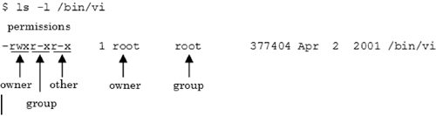
Permissions and file modes(2/3)

Slide 9
Permissions and file modes(3/3)
Octal
00400 00200 00100 00040 00020 00010 00004 00002 00001
Symbol
S_IRUSR S_IWUSR S_IXUSR S_IRGRP S_IWGRP S_IXGRP S_IROTH S_IWOTH S_IXOTH
Meaning
read by owner write by owner execute by owner read by group write by group execute by group read by others write by others execute by others
<sys/stat.h>
S_IRUSER | S_IRGRP | S_IROTH = 0444 = r--r--r--
S_IRUSR | S_IWUSR | S_IXUSR | S_IRGRP | S_IXGRP | S_IXOTH | S_IXOTH
= 0755 = rwx-r-xr-x

Slide 10
open(2) and file permissions
If open is used to open an existing file
then the system checks whether the mode of access requested by the process is allowed by checking the file’s permission
If the process does not have the requested access permission, open will return -1 (errno=EACCESS)
When we open a file, the kernel performs its access tests based on the effective user and group IDs
filedesc = open(pathname, O_RDONLY|O_CREAT|O_TRUNC, 0600);
/* the file in question will be truncated if it exists */
filedesc = open(pathname, O_RDONLY|O_CREAT|O_EXCL, 0600);
/* if the file exists, return -1 (errno = EEXIST)*/

Slide 11
example
-r--r--rw- usr1 grp1 file1
-r--rw---- usr2 grp1 file2
-------r-- usr1 grp1 file3
-rw-rw-rw- usr1 grp2 file4
--w-rw---- usr2 grp2 file5
-rwxrwxrwx usr1 grp1 a.out
fd1 = open(“file1”, O_RDONLY);
fd2 = open(“file2”, O_RDONLY);
fd3 = open(“file3”, O_RDONLY);
fd4 = open(“file4”, O_RDONLY);
fd4 = open(“file5”, O_RDONLY);
user’s shell
a.out
$ ./a.out
ruid = usr1
euid = usr1
rgid = grp1
egid = grp1
ruid =
euid =
rgid =
egid =

Slide 12
The file access tests
The tests performed by the kernel are as follows.
If the effective user ID of the process is 0 (the superuser), access is allowed.
If the effective user ID of the process equals the owner ID of the file (i.e., the process owns the file), access is allowed if the appropriate user access permission bit is set. Otherwise, permission is denied.
If the effective group ID of the process equals the group ID of the file, access is allowed if the appropriate group access permission bit is set. Otherwise, permission is denied.
If the appropriate other access permission bit is set, access is allowed. Otherwise, permission is denied.

Slide 13
Extra permission for executable files(1/3)
Usually only relevant when a file contains an executable program.
If the S_ISUID permission is set, then when the executable file is started,
The system gives the resulting process an effective user-id taken from the file owner rather than user-id of the user who started the process
Octal
04000 02000 01000
Symbol
S_ISUID S_ISGID S_ISVTX
Meaning
Set user-id on execution Set group-id on execution Save-text-image (sticky bit)
<sys/stat.h>

Slide 14
Extra permission for executable files(2/3)
$ id
uid=100(user1) gid=500(group1) groups=500(group1)
$ ls –l
-rwxr-xr-x 1 user2 group2 0 2월 10 21:44 a.out
$ ./a.out
ruid =100
euid =100 rgid =500
egid =500
user’s shell
a.out
ruid =100
euid =100
rgid =500
egid =500
user2$ chmod u+s a.out
$ id
uid=100(user1) gid=500(group1) groups=500(group1)
$ ls –l
-rwsr-xr-x 1 user2 group2 0 2월 10 21:44 a.out
$ ./a.out
ruid =100
euid =100 rgid =500
egid =500
user’s shell
a.out
ruid =100
euid =200
rgid =500
egid =500

Slide 15
Extra permission for executable files(3/3)
sticky bit ( save-text-image)
S_ISVTX bit used to be able to be set on executable files
In earlier systems if the save-text-image bit was set on a file, then, it was execute, its program-text part would remain in the system’s swap area until the system was halted.
On modern day UNIX system this bit is now redundant.
Contemporary systems define the S_ISVTX bit for directories

Slide 16
How do you change your password?
We can not directly change /etc/shadow
But, usr/bin/passwd can change /etc/shadow
$ ls –l /etc/shoadow
-r-------- 1 root root 2618 8월 6 21:43 /etc/shadow
$ id
uid=100(user1) gid=500(group1) groups=500(group1)
$ ls –l /bin/passwd
-rwsr-xr-x 1 root root 22984 8월 6 21:43 /usr/bin/passwd
$
$ passwd
(current) UNIX password:
user’s shell
passwd
passwd cange
/etc/shadow
ruid =100
euid =100 rgid =500
egid =500
ruid =100
euid =0 (root)
rgid =500
egid =500

Slide 17
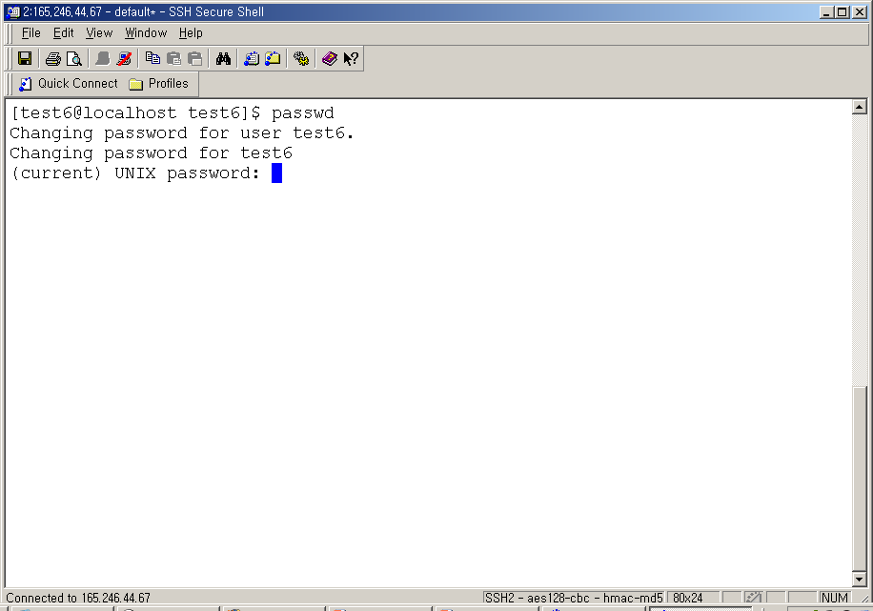
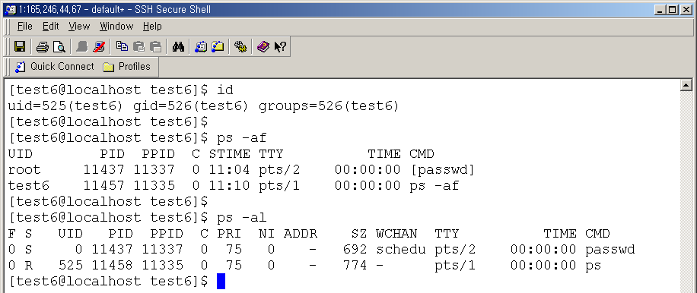

Slide 18
The file creation mask
Associated with each process is a value called the file creation mask
file creation mask (safeguarding)
Turn off particular permission bits automatically whenever a file is created.
Prevents the specified permissions from being accidentally turned on.
filedesc = open(pathname, O_CREAT, mode)
filedesc = open(pathname, O_CREAT, (~mask) & mode)
Notes:
각 프로세스는 디폴트 파일 생성마스크 값을 가짐
이것은 생성되는 파일에 부여되지 말아야 할 허가 권한들의 비트 마스크임
사용자가 open이나 creat시스템 콜을 사용할 때 mode를 지정하면 커널은 디폴트 마스크에 지정된 비트들을 소거한다.

Slide 19
The umask(2) system call
#include <sys/stat.h>
mode_t umask(mode_t cmask);
Returns: previous file mode creation mask
The umask function sets the file mode creation mask for the process
umask(1)
$ umask
$ umask –S
$ umask 22
mode_t oldmask; /* 이전 마스크 값을 저장하기 위한 */
.
.
.
oldmask = umask(022); /* 파일 소유자이외의 사용자에게 쓰기 허가를 막는다 */
Notes:
02_umask.c

Slide 20
example p.45 (62)
#include <fcntl.h>
#include <sys/stat.h>
int specialcreat (const char *pathname, mode_t mode){
mode_t oldu;
int filedes:
/* 화일 생성 마스크를 0으로 설정 */
if ( (oldu = umask(0)) == ―1){
perror ("saving old mask");
return (-1);
}
/* 화일을 생성한다 */
if((filedes=open(pathname, O_WRONLY｜O_CREAT｜O_EXCL, mode))== -1)
perror ("opening file");
/* 비록 개방에 실패하더라도, 과거의 화일 모드를 복원한다. */
if (umask (oldu) == -1)
perror ("restoring old mask");
/* 화일 기술자를 복귀한다. */
return filedes;
}

Slide 21
The access(2) system call
#include <unistd.h>
int access(const char *pathname, int amode);
Returns: 0 if OK,-1 on error
The access check access permissions of pathname based on the real user and group IDs
Arguments
amode
R_OK test for read permission.
W_OK test for write permission.
X_OK test for execute permission.
F_OK test for existence of file
errno | cause
EACCES | file’s permission do not allow the required access
ENOENT | file simply does not exist

Slide 22
example p.47 (65)
/*access의 사용 예 */
#include <stdio.h>
#include <stdlib.h>
#include <unistd.h>
main()
{
char *filename = "afile";
if (access (filename, R_OK) == -1)
{
fprintf (stderr, "User cannot read file %s\n", filename);
exit (1);
}
printf ("%s readable, proceeding\n", filename);
/* 프로그램의 나머지 부분... */
}

Slide 23
The chmod(2) system call
#include <unistd.h>
int chmod(const char *pathname, mode_t newmode);
Returns: 0 if OK,-1 on error
Alter the permission of an existing file.
Only by the file’s owner or superuser
if( chmod(pathname, 0644) == -1 )
perror(“call to chmod failed”);

Slide 24
The chown(2) system call
#include <unistd.h>
int chown(const char *pathname, uid_t owner_id, gid_t group_id);
Returns: 0 if OK,-1 on error
Allow us to change the user ID of a file and the group ID of a file.
Arguments
owner_id : new owner
group_id : new group
The error EPERM is always returned on any illegal attempt to change the ownership of a file.
set-user-id and set-group-id permission are turned off for a file when the ownership of that file is altered.
if either of the arguments owner_id or group_id is -1, the coressponding ID is left unchanged.

Slide 25
3.2 File with multiple names

Slide 26
File System
A File System is a software component, which builds a logical structure for storing files on storage devices(hard disks etc.)
It appears as a hierarchical structure in which files and folder can be stored. The top of the hierarchy of each File System is usually “root”
A File System specifies naming conventions for naming files and folders

Slide 27
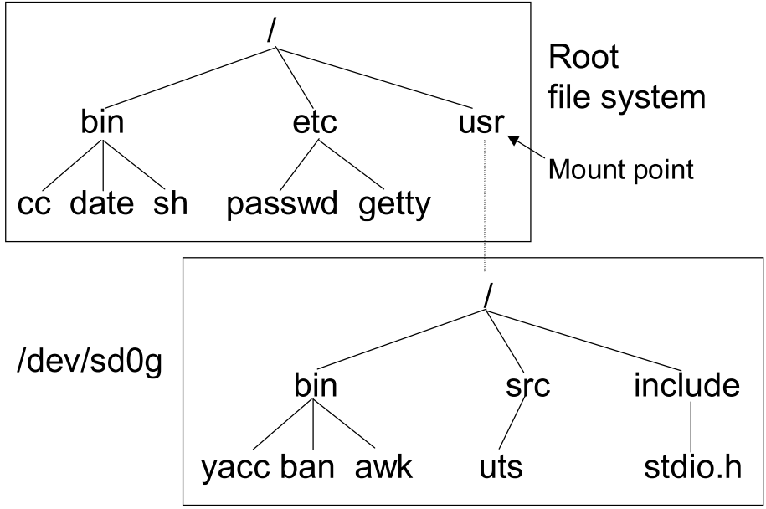
File System
Mount-on
A directory is covered by the mounted file system.
Mount table & vfs list
Notes:
하나의 파일 시스템이 루트 파일 시스템으로 설정되고, 이 파일 시스템의 루트 디렉토리가 시스템 루트 디렉토리가 된다. 다른 파일 시스템들은 기존의 트리에 있는 디렉토리에 마운팅 됨으로써 기존의 파일 시스템 구조에 부착된다.
Mount-on된 디렉토리로의 모든접근은 새롭게 마운트 된 파일 시스템의 루트 디렉토리의 접근으로 해석된다.

Slide 28
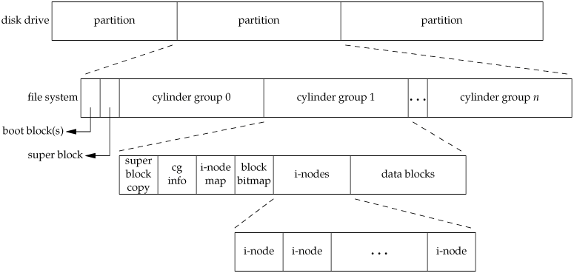
UNIX File System(1/2)
To appreciate the concept of links to a file, we need a conceptual understanding of the structure of the UNIX file system.
Various implementation of the UNIX file system are in use today. (UFS, PCFS, HSFS..)
Notes:
파일 : 데이터를 위한 container
파일시스템: 사용자가 상이한 파일들을 구성, 조작하고 접근할 수 있도록 한다.
각 파일에 대해 파일 이름 이외에 여러가지 속성들을 유지한다. 이러한 속성들은 디렉토리 항에 저장되지 않고, inode라고 하는 디스크 구조체에 저장된다

Slide 29
UNIX File System(2/2)
Boot block
Boot code that is used when UNIX is first activated.
Super Block
the total number of blocks in the file system
the number of inodes in the inode free list
a bit map of free blocks
the size of block in bytes
the number of free blocks
the number of used blocks
i-nodes
all the inodes associated with the files on the disk
uniquely identifies a file
data blocks
for storing file blocks
Notes:
Block
- 보통 유닉스에서 블록의 크기는 ‘514Byte X 2의 배수’ 로 정의된다. (512,1024,2048)
Boot block
- 운영체제를 부트스랩(로드하고 초기화)할때 필요한 코드가 있다.
- 단 하나의 파티션만이 이러한 정보를 수록하며, 다른 파티션은 비어 있는 부트 영역을 가지게 됨.
Super block
- 파일 시스템 자체의 속성과 메타데이터를 가지고 있음
i-node (index node라는 말에서 유래됨)
- 각 파일은 하나의 inode가 할당
- i-node번호는 inode리스트 내에서 인덱스와 동일하다
- s5fs에서 inode크기는 64바이트임.
- blok당 여러 개의 i-node들이 들어가게된다.
- inode 리스트는 고정된 크기(파티션 상에 파일 시스템이 구축되는 중에 구성)이기 때문에 한 파티션이 가질 수 있는 파일의 수가 제한된다.

Slide 30
i-node
Each file (regular, directory, special, etc.) use one i-node and must be linked to from at least one directory.
Files that have data on disk-regular, directory, and symbolic link-also have data blocks pointed to from their i-nodes.
I-nodes 0 and 1 aren’t used.
0 : used to mean “no i-node”
1 : used to collect bad disk blocks.
I-node 2 is reserved for the root directory(/)

Slide 31
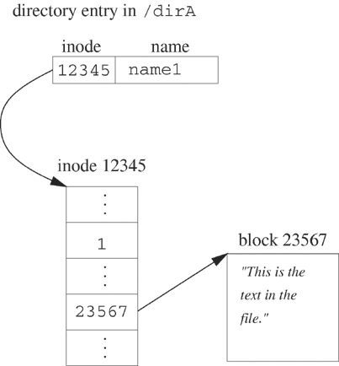
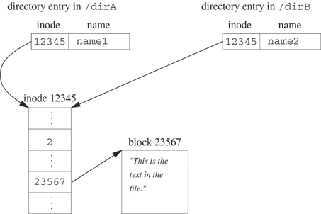
Hard link & Symbol link (1/2)
Hard link
Hard link is an direct pointer to a file.
Link count is the number of directory entries that point to the i-node.
Only when the link count goes to 0 can the file be delete.
These type of links are called hard links.
Can’t cross file systems
Only the superuser can create a hard link to directory
$ ls –i /dirA/name1 /dirB/name2 12345 /dirA/name1 12345 /dirA/name2
$ ln /dirA/name1 /dirB/name2

Slide 32
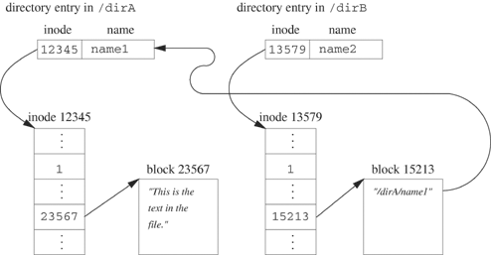
Hard link & Symbol link (2/2)
Symbol link
Symbolic link is an indirect pointer to a file.
Actual contents of symbol link is the file which it is linked.
No file system limitions
In hard and symbol links, a hard link is created
but, the hard link created by symbol link is to a file that contains the path-string.
$ln –s /dirA/name1 /dirB/name2
lrwxrwxrwx 1 root root Sep 10 07:14 name2 -> dirA/name1

Slide 33
The link(2) system call
#include <unistd.h>
int link(const char *orginal_path, const char *new_path);
Returns: 0 if OK, -1 on error
Creation of new directory entry and the increment of the link count.
Creation of hard link to directories
It is restricted to only the superuser.(because, file system loop)
Arguments
Both pathnames be on the same file system.
link(“/usr/keith/chap.2”, “/usr/ben/2.chap”);

Slide 34
The unlink(2) system call
#include <unistd.h>
int unlink(const char *pathname);
Returns: 0 if OK, -1 on error
Remove an existing directory entry
Remove just the link named, and reduce the file’s link count by one.
If there are other links to the file, the data in the file is still accessible through the other links.
If link count reduced to 0, the disk blocks added to a list of free blocks.
Unlink permission ?

Slide 35
example p.50 (69)
/* move -- 한 화일을 하나의 경로이름으로부터 다른 경로이름으로 옮긴다. */
#include <stdlib.h>
#include <stdio.h>
#include <unistd.h>
char *usage = "usage: move file1 file2\n";
/* main은 명령줄에 의해 표준적인 방법으로 전달된 인수를 사용한다. */
main (int argc, char **argv){
if (argc != 3){
fprintf (stderr, usage); exit (1);
}
if ( link (argv[1], argv[2]) == -1){
perror ("link failed");
exit (1);
}
if ( unlink(argv[1]) == -1){
perror ("unlink failed");
unlink (argv[2]);
exit (1);
}
printf ("Succeeded\n");
}

Slide 36
The remove(3) system call
#include <stdio.h>
int remove(const char *pathname);
Returns: 0 if OK, -1 on error
For a file, remove is identical to unlink.
ISO C specifies the remove function to delete a file.
The name was changed from the historical UNIX name of unlink because most non-UNIX systems that implement the C standard didn't support the concept of links to a file at the time.

Slide 37
The rename(2) system call
#include <stdio.h>
int rename(const char *oldname, const char *newname);
Returns: 0 if OK, -1 on error
A file or a directory is renamed with the rename function.
This function is defined by ISO C for files. (The C standard doesn't deal with directories.) POSIX.1 expanded the definition to include directories and symbolic links.
Arguments
If the oldname and newname refer to same file, the function return successfully without changing anything

Slide 38
The symlink(2) system call
#include <unistd.h>
int symlink(const char *realname, const char *symname);
Returns: 0 if OK, -1 on error
If symbolic link file is ever opened with open then the open system call correctly follows the path to realname.
If a programmer wishes to see the data held in symname itself then the system call readlink must be used.

Slide 39
The readlink(2) system call
#include <unistd.h>
ssize_t readlink(const char* sympath, char* buffer, size_t bufsize)
Returns: number of bytes read if OK, -1 on error
The readlink system call
1. opens sympath
2. read the contents of the file into buffer
3. close sympath
If the original file is removed,
A program will still be able to ‘see’ the symbolic link but unfortunately an open call will not be able to follow the path contained within it and will return with errno set to EEXIST.

Slide 40
3.3 Obtaining file information: stat and fstat

Slide 41
The stat(2) system call(1/2)
#include <sys/stat.h>
int stat(const char *pathname, struct stat *buf);
int fstat(int filedes, struct stat *buf);
int lstat(const char *pathname, struct stat *buf);
All three return: 0 if OK, -1 on error
These functions obtain information about the file
stat : named file
fstat : open file
lstat : symbolic link
Notes:
lstat는 stat와 동일, 하지만 path가 symlink일 경우 following되지 않는다.
flstat가 없는 이유는 symlink를 open하면 무조건 following되기 때문이다.
fstat는 unnamed pipe혹은 socket과 같은 파일에 대해 정보를 얻을 때 유용하다.

Slide 42
The stat(2)system call(2/2)
Argument
buf
struct stat {
mode_t st_mode; /* file type & mode (permissions) */
ino_t st_ino; /* i-node number (serial number) */
dev_t st_dev; /* device number (file system) */
dev_t st_rdev; /* device number for special files */
nlink_t st_nlink; /* number of links */
uid_t st_uid; /* user ID of owner */
gid_t st_gid; /* group ID of owner */
off_t st_size; /* size in bytes, for regular files */
time_t st_atime; /* time of last access */
time_t st_mtime; /* time of last modification */
time_t st_ctime; /* time of last file status change */
blksize_t st_blksize; /* best I/O block size */
blkcnt_t st_blocks; /* number of disk blocks allocated */
};
Notes:
st_dev (dev_t) : 마운트한 파일시스템을 유니크하기 식별하는 번호
- st_dev와 st_ino의 combination은 inode를 유일하게 식별한다.
- device ID는 major와 minor번호로 나뉨, major는 driver를 나타내고, minor는 device를 나타냄
st_rdev : spercial 파일이 가리키는 device
예를 들어 special file /dev/ad0s1g는 root파일시스템에 있음. 따라서, st_dev는 root파일시스템의 디바이스 번호이다.
반면, st_rdev는 /dev/ads1g가 가리키는 장치번호이다.
st_size :
- regular filde에 대해 이것은 data size를 가리킨다.
- shared memory : memory size
- pipe : the amount of data in the pipe., 즉, 안 읽은 data의 양

Slide 43
example p.55 (75) (1/2)
/* filedata -- 한 화일에 관한 정보를 출력 */
#include <stdio.h>
#include <sys/stat.h>
/* 허가 비트가 설정되어 있는지 결정하기 위해 octarray를 사용 * /
static short octarray[9] = { 0400, 0200, 0100,
0040, 0020, 0010,
0004, 0002, 0001};
/* 화일 허가에 대한 기호화 코드 끝부분의 null 때문에 길이가 10문자이다. */
static char perms[10] = "rwxrwxrwx";
int filedata (const char *pathname)
{
struct stat statbuf;
char descrip[10];
int j:
if(stat (pathname, &statbuf) == -1)
{
fprintf (stderr, "Couldn't stat %s\n", pathname);
return (-1);
}

Slide 44
example p.55 (75) (2/2)
st_mode
/* 허가를 읽기 가능한 형태로 바꾼다. */
for(j=0; j<9; j++)
{
/ * 비트별 AND를 사용하여 허가가 설정되었는지 테스트 */
if (statbuf.st_mode & octarray[j])
descrip[j] = perms[j];
else
descrip[j] = '-';
}
descrip[9] = '\0'; /* 하나의 문자열을 가지도록 확인 */
/* 화일 정보를 출력한다. */
printf ("\nFile %s :\n", pathname);
printf ("Size %ld bytes\n", statbuf.st_size);
printf ("User-id %d, Group-id %d\n\n", statbuf.st_uid, statbuf.st_gid);
printf ("Permissions: %s\n", descrip);
return (0);
}
type | special |  |  | Permission
4 bit | u | g | s | r | w | x | r | w | x | r | w | x
[0]:0400, [1]:0200, [2]:0100,
[3]:0040, [4]:0020, [5]:0010,
[6]:0004, [7]:0002, [8]:0001
012345678 rwxrwxrwx
0 | 1 | 2 | 3 | 4 | 5 | 6 | 7 | 8

Slide 45
example p.56 (76) (1/2)
/* lookout -- 화일이 변경될 때 메시지를 프린트 */
#include <stdlib.h>
#include <stdio.h>
#include <sys/stat.h>
#define MFILE 10
void cmp(const char *, time_t);
struct stat sb;
main (int argc, char **argv)
{
int j;
time_t last_time[MFILE+1];
if(argc < 2){
fprintf (stderr, "usage: lookout filename ...\n");
exit (1);
}
if(――argc > MFILE){
fprintf (stderr, "lookout: too many filenames\n");
exit (1);
}
argc | 3
argv[0] | a.out
argv[1] | test1
argv[2] | test2
0
1
…
10

Slide 46
example p.56 (76) (2/2)
for (j=1; j<=argc; j++){ /* 초기화 */
if (stat (argv[j], &sb) == -1){
fprintf (stderr, "lookout: couldn't stat %s\n", argv[j]);
exit (1);
}
last_time[j] = sb.st_mtime;
}
for (;;){ /* 화일이 변경될 때까지 루프 */
for (j=1; j<=argc; j++)
cmp (argv[j], last_time[j]);
/* 60초간 쉰다. “sleep"는 표준 UNIX 라이브러리 루틴이다. */
sleep (60);
}
}
void cmp(const char *name, time_t last){
/* 화일에 관한 통계를 읽을 수 있는 한 변경시간을 검사한다. */
if (stat(name, &sb) == ―1 || sb.st_mtime ! = last){
fprintf (stderr, "lookout: %s changed\n", name);
exit (0);
}
}
0
1 | time
2 | time
10
argv[0] | a.out
argv[1] | test1
argv[2] | test2

Slide 47
example p.58 (79)
/* addx -- 화일에 수행허가를 추가 */
#include <stdlib.h>
#include <stdio.h>
#include <sys/stat.h>
#define XPERM 0100 / * 소유자에 대한 수행 허가 */
main(int argc, char **argv){
int k;
struct stat statbuf;
for (k=1; k<argc; k++){/* 인수 리스트의 모든 화일에 대해 루프 */
/* 현행 화일 모드를 얻음 */
if (stat (argv[k], &statbuf) == -1){
fprintf (stderr, "addx: couldn't stat %s\n", argv[k]);
continue;
}
/* 비트별 OR 연산을 사용하여 수행허가의 추가를 시도 */
statbuf.st_mode |= XPERM; //statbuf.st_mode = statbuf.st_mode + XPERM;
if (chmod (argv[k], statbuf.st_mode) == -1)
fprintf (stderr, "addx: couldn't change mode for %s\n", argv[k]);
} /* 루프의 끝 */

